Slide 1
Statistical Learning in R
Wendy Martinez
Bureau of Labor Statistics
WiDS 2019

Slide 2
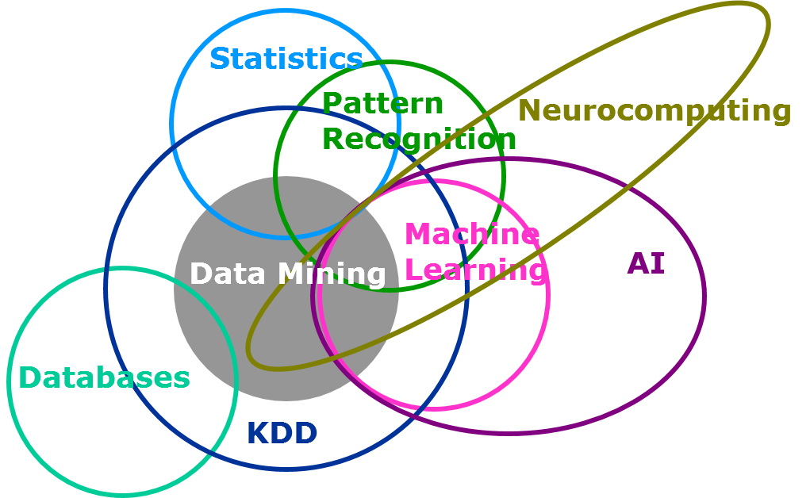
What is Statistical Learning?
Learning from data
Understand underlying phenomena generating the data
https://www.analyticsvidhya.com/blog/2015/07/difference-machine-learning-statistical-modeling/

Slide 3
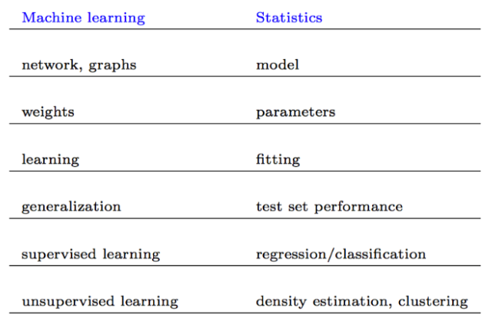
Statistical Learning
https://www.analyticsvidhya.com/blog/2015/07/difference-machine-learning-statistical-modeling/

Slide 4
Statistical Learning
Two main types of learning from data
Supervised learning
Observations are labeled with truth
Learn the relationship between them
Predictors and response variables
EX: regression, classification

Slide 5
Statistical Learning
Unsupervised learning – not discussed today
No labels or ground truth
Just have data & look for interesting structure
Usually exploratory
An example is clustering.
Find groups, if any
Data in a group are similar and different from data in other groups.

Slide 6
Learning in R
Many, many packages in R for statistical learning – both but just supervised today
All with different syntax for training and prediction
Max Kuhn developed the caret package (~2008) to provide a unified and streamline process
Classification and Regression Training

Slide 7
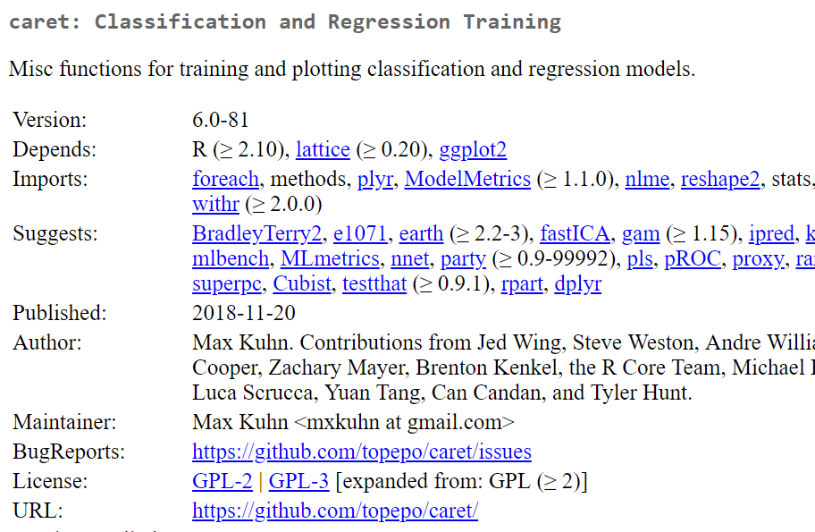
Caret Package
Can find it on CRAN
https://cran.r-project.org/web/packages/caret/index.html
There are some references & links.

Slide 8
Caret Package
Has many useful tools
Data splitting – testing and training sets
Pre-processing
Feature selection
Model tuning
Estimating variable importance
More …
Provides a unifying framework to explore different models

Slide 9
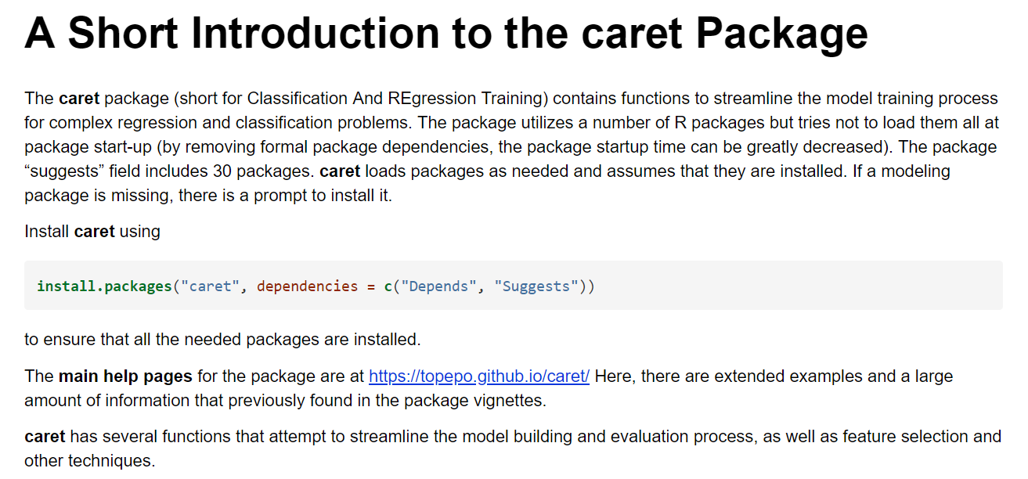
Caret
We will illustrate just a few of the features – enough to get you started.
Resources at the end to learn more about caret.

Slide 10
What We’ll Cover
Visualizing data
Pre-processing data
Cross-validation
Model building or training
Variable importance
Measuring performance

Slide 11
Visualizations
We follow the online book by Kuhn and use two simple data sets for illustration.
Regression modeling – Boston housing data
Classification – Fisher’s iris data
Let’s look at these two data sets…
Install caret, AppliedPredictiveModeling, and mlbench packages.

Slide 12
Visualizations
It is always a good idea to view your data before building models.
The caret package has a function called featureplot.
It is a wrapper for lattice plots of predictors.
Classification: box, strip, density, pairs, ellipse
Regression: pairs or scatter
Let’s look at some examples ….

Slide 13
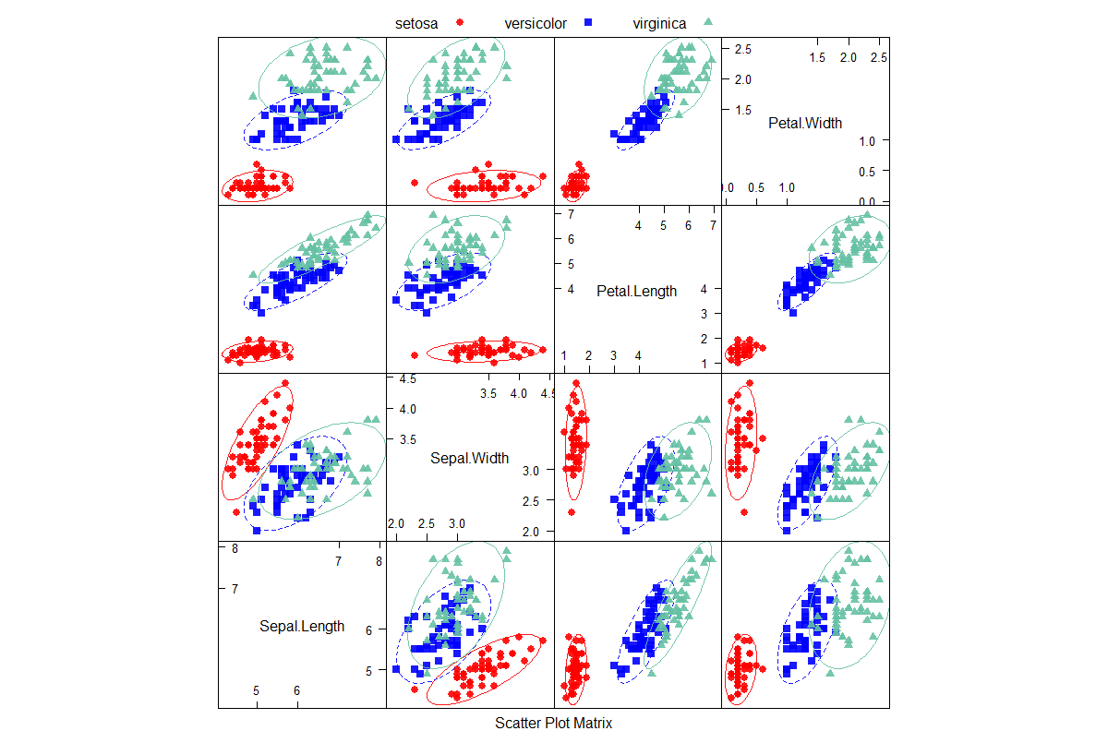
Scatter plot Matrix

Slide 14
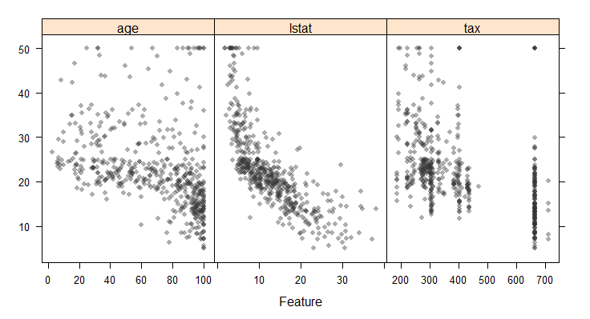
Scatter plots of Predictors with Response Variable

Slide 15
Pre-Processing Data
Has several options to pre-process predictor data.
Assumes all are numeric and any factors have been converted to dummy variables, e.g., using dummyVars (part of caret).
There is a preProcess function can be used to implement several options.
Let’s look at help: ?preProcess

Slide 16
Build Models
The caret package has a function train to build models.
Features
Use different parameters to build model
Evaluate models using resampling
Choose ‘best’ model
Estimate model performance

Slide 17
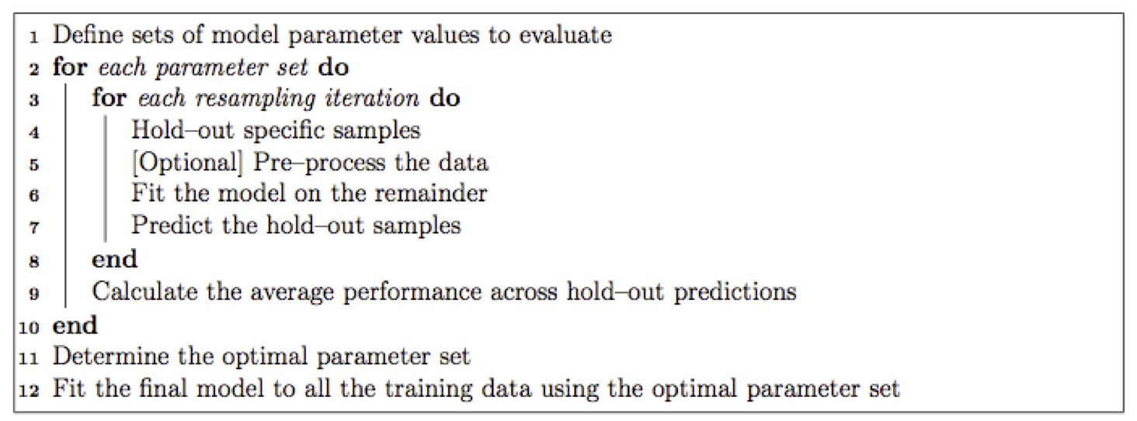
Build Models
https://cran.r-project.org/web/packages/caret/vignettes/caret.html

Slide 18
Data Splitting
We need two data sets with ground truth for training and testing.
We can use the createDataPartition function to create these two data sets.
If the response is a factor (classification), then the random sampling is done so the class distribution is maintained.
Returns a vector of index numbers for observations in the training set.
Let’s look at some examples …..

Slide 19
Choose Models
The caret package makes it easy to try out different models and compare results.
It has 237 models as of 2018.
Find the list here:
https://topepo.github.io/caret/available-models.html
The function getModelInfo provides information.
Look at ?getModelInfo
https://github.com/topepo/caret/tree/master/models/files

Slide 20
Classification Example
Let’s look at a classification example using the iris data.
We keep this simple and look at two options – linear and quadratic classifiers
Go to R script….

Slide 21
Regression Example
Now, we look at a regression example using the Boston Housing data.
Again, we are keeping this simple and will look at a linear (least squares) model.
Go to R script …

Slide 22
Resources
https://cran.r-project.org/web/packages/caret/index.html
https://cran.r-project.org/web/packages/caret/vignettes/caret.html
https://topepo.github.io/caret/ # Main help pages
http://appliedpredictivemodeling.com/ # Kuhn’s book
https://www.jstatsoft.org/article/view/v028i05 # Journal article
https://github.com/topepo/caret # GitHub project
https://topepo.github.io/caret/available-models.html # Models in caret
https://www.analyticsvidhya.com/blog/2014/12/caret-package-stop-solution-building-predictive-models/ # Ref for regression example
https://topepo.github.io/caret/index.html # Main source for these note
https://www.analyticsvidhya.com/blog/2016/12/practical-guide-to-implement-machine-learning-with-caret-package-in-r-with-practice-problem/
https://www.machinelearningplus.com/machine-learning/caret-package/
https://datascienceplus.com/machine-learning-with-r-caret-part-1/

Slide 23
Wendy Martinez Bureau of Labor Statistics martinez.wendy@bls.gov 202-691-7400

